Slide 1






JavaScript (Functions in JavaScript)
www.wscubetech.com

Slide 2
Our Agenda.
What are functions?
How to make user defined functions.
Types of functions.
www.wscubetech.com

Slide 3
What are functions?
A loop is used to repeat a block of code until the specified condition is met.
Functions in JavaScript are reusable blocks of code designed to perform specific tasks.
www.wscubetech.com

Slide 4
Types of functions.
Functions
Pre defined
Such functions are defined at the time of making of any language.
Such function are defined by users according to their needs.
User defined
www.wscubetech.com

Slide 5
User Define Function
Simple Function
Return Statement
Argument function
www.wscubetech.com

Slide 6
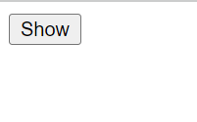
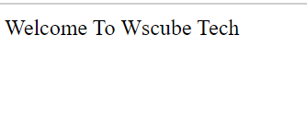
Simple Function In JavaScript
JavaScript :
<script type="text/javascript">
function showData()
{
document.write("Welcome To Wscube Tech");
}
</script>
HTML :
<form>
<input type="button" value="Show" onclick="showData()">
</form>
Click
www.wscubetech.com

Slide 7
Arguments Function In JavaScript
JavaScript :
<script type="text/javascript">
function showImage(i)
{
if (i==1) {
document.getElementById('img1').src="02.jpeg";
document.getElementById('img2').src="01.jpeg";
}
else{
document.getElementById('img1').src="01.jpeg";
document.getElementById('img2').src="02.jpeg";
}
}
</script>
HTML :
<body>
<img src="01.jpeg" id="img1" width="200px" height="200px" onmouseover="showImage(1)" onmouseout="showImage(2)">
<img src="02.jpeg" id="img2" width="200px" height="200px" onmouseover="showImage(1)“ onmouseout="showImage(2)">
</body>
www.wscubetech.com

Slide 8


Output
Without Hover
Without Hover
With Hover
www.wscubetech.com

Slide 9
Return Statement In JavaScript
JavaScript :
<script type="text/javascript">
function addData(a,b){
return a+b;
}
function showdata(a,b){
var t=addData(a,b);
alert("Total Value =>"+t);
}
</script>
HTML :
<body>
<button onclick="showdata(10,20)">
Show
</button>
</body>
www.wscubetech.com

Slide 10
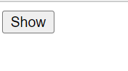
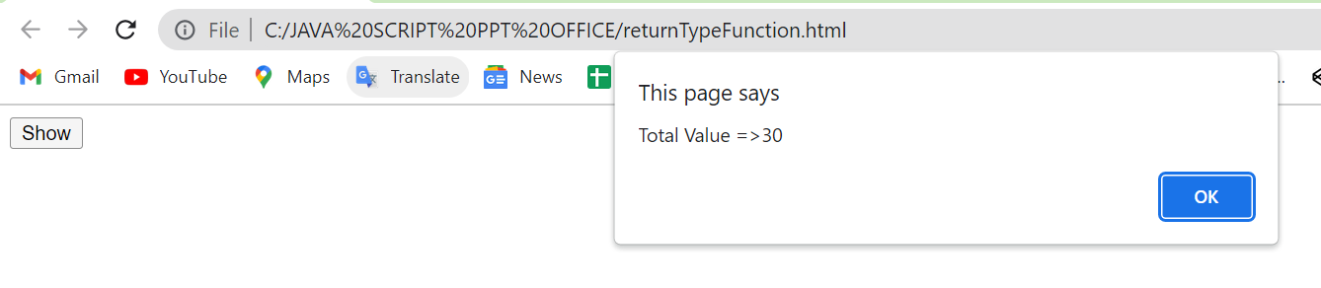
Output
Without Hover
Click
Output
www.wscubetech.com

Slide 11



@wscube
@wscubetech.india
www.wscubetech.com
Subscribe To Get Notified about New Videos

